Slide 1
PCA + K-Means Clustering - HW#8
MACHINE LEARNING EE5354
Javier Salazar
1001144647

Slide 2
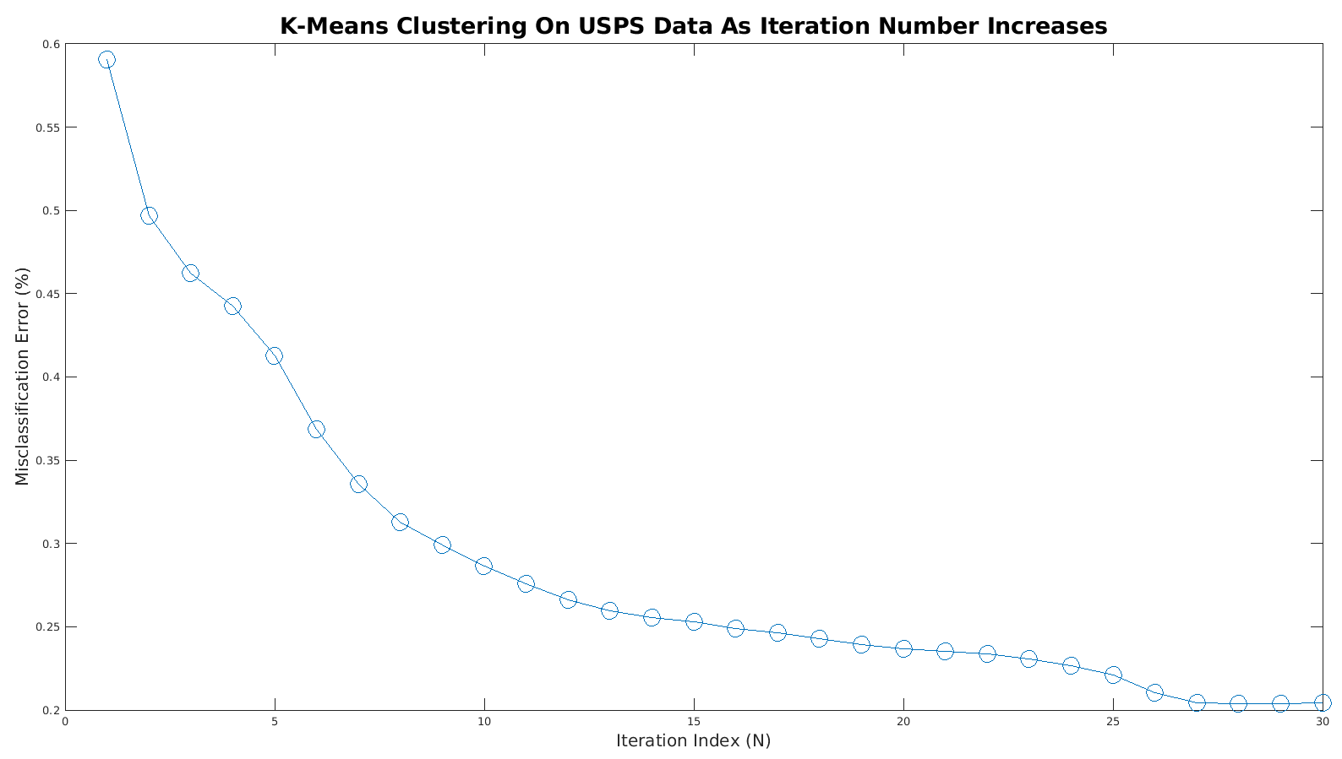
Clustering (Clusters = 10)

Slide 3
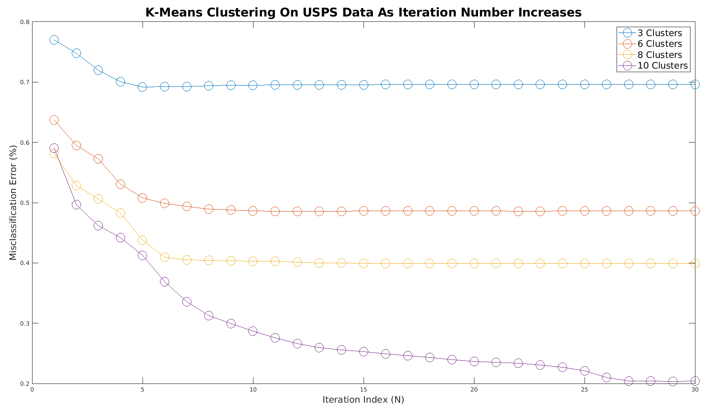
Clustering (Multi Cluster)

Slide 4
Clustering Analysis
Only one iteration → ~60% error (Clusters = 10)
30 iterations → ~20% error (Clusters = 10)
Randomly assigning labels would result in 90% misclassification error so results are pretty good after 30 iterations for 10 clusters
Results seem to stagnate after 30 iterations
L2 norm utilized for distance metric

Slide 5
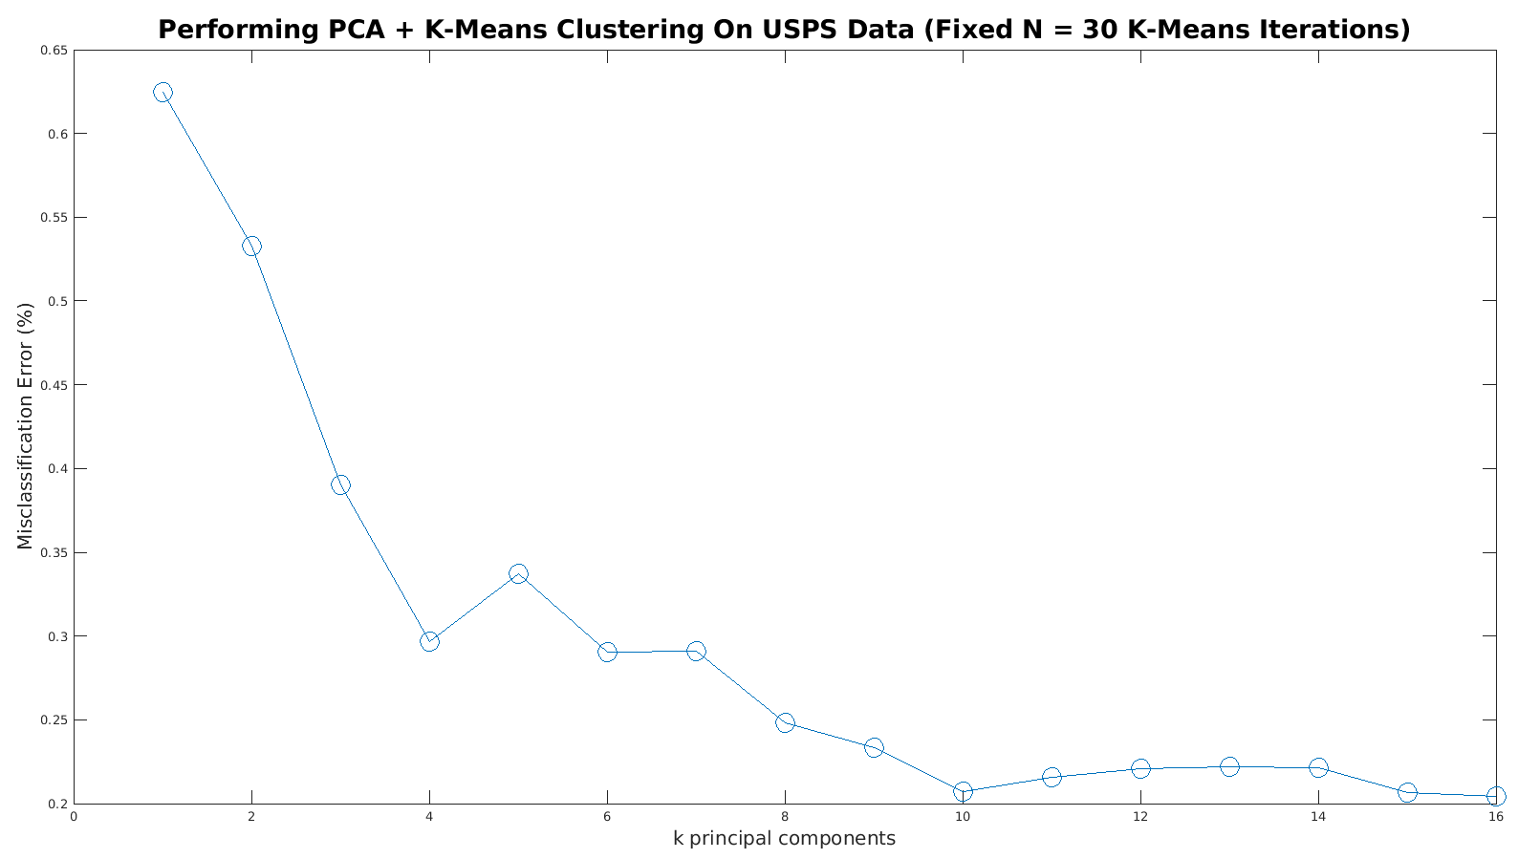
PCA + Clustering (Clusters = 10)

Slide 6
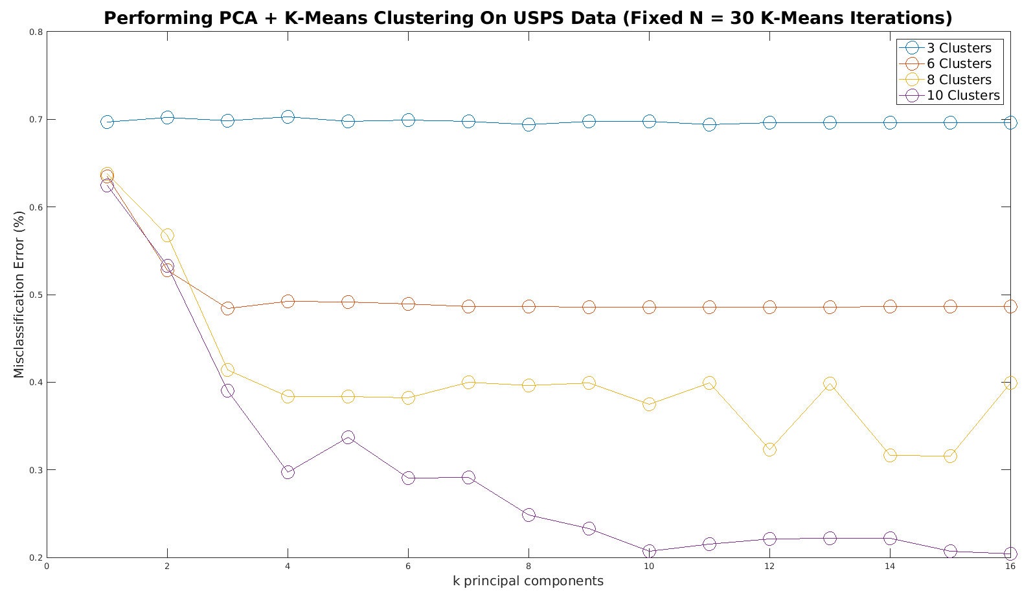
PCA + Clustering (Multi-Class)

Slide 7
PCA + Clustering Analysis
Clustering iterations fixed to N = 30 iterations since that lead to good results in clustering problem
1 comp. → ~63% misclassification error (Clusters = 10)
10 comp. → ~20% misclassification error (Clusters = 10)
16 comp. → ~20% misclassification error (Clusters = 10)
Looks like we can keep the first 10 component vectors without really losing any important information in this example
L2 norm used for distance metric during clustering

Slide 8
File Information
The file ‘cluster.m’ is to generate the plot of how the misclassification error changes as we increase K-Means iterations
The file ‘script_clusters.m’ is to generate the PCA plot of misclassification error changes as we increase number of component vectors
Both files have fixed random seed (e.g. rng(7777)) to directly observe effects of increasing iterations or components on misclassification error otherwise results could be misleading

